Slide 1
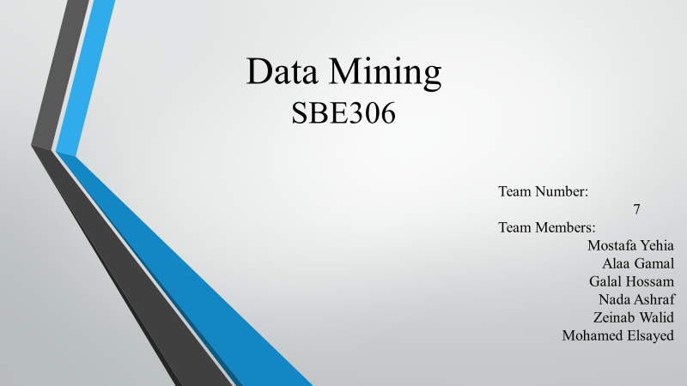

Slide 2
Data Mining:
Concepts and Techniques

Slide 3
Introduction
Motivation: Why data mining?
What is data mining?
Types of data mining
Data Mining: On what kind of data?
Classification of data mining systems

Slide 4
Why Data Mining?
The Explosive Growth of Data: from terabytes to petabytes
  Data collection and data availability
    Automated data collection tools, database systems, Web, computerized society
  Major sources of abundant data
    Business: Web, e-commerce, transactions, stocks, …
    Science: Remote sensing, bioinformatics, scientific simulation, …
    Society and everyone: news, digital cameras,
We are drowning in data, but starving for knowledge! John Naisbitt
“Necessity is the mother of invention” Proverb

Slide 5
Evolution of Database Technology
1960s:
  Data collection, database creation, IMS and network DBMS
1970s:
  Relational data model, relational DBMS implementation
1980s:
  RDBMS, advanced data models (extended-relational, OO, deductive, etc.)
  Application-oriented DBMS (spatial, scientific, engineering, etc.)
1990s:
  Data mining, data warehousing, multimedia databases, and Web databases
2000s
  Stream data management and mining
  Data mining and its applications
  Web technology (XML, data integration) and global information systems

Slide 6
What Is Data Mining?
Data mining (knowledge discovery from data)
  Extraction of interesting (non-trivial, implicit, previously unknown and potentially useful) patterns or knowledge from huge amount of data
Alternative name
  Knowledge discovery in databases (KDD)
Watch out: Is everything “data mining”?
  Query processing
  Expert systems or statistical programs

Slide 7
Types of data mining
Prospective exploration
  Prospective exploration produces a model of the system that is described in the data used for exploration.
Descriptive exploration
  In Descriptive exploration, new information is produced based on the information contained within the data used in the exploration process.

Slide 8
Why Data Mining? Potential Applications
Data analysis and decision support
  Market analysis and management
    Target marketing, customer relationship management (CRM), market basket analysis, market segmentation
  Risk analysis and management
    Forecasting, customer retention, quality control, competitive analysis
  Fraud detection and detection of unusual patterns (outliers)

Slide 9
Why Data Mining? Potential Applications
Other Applications
  Text mining (news group, email, documents) and Web mining
  Stream data mining
  Bioinformatics and bio-data analysis

Slide 10
Market Analysis and Management
Where does the data come from?
  Credit card transactions, discount coupons, customer complaint calls
Target marketing
  Find clusters of “model” customers who share the same characteristics: interest, income level, spending habits, etc.
  Determine customer purchasing patterns over time

Slide 11
Market Analysis and Management
Cross-market analysis
  Associations/co-relations between product sales, & prediction based on such association
Customer profiling
  What types of customers buy what products
Customer requirement analysis
  Identifying the best products for different customers
  Predict what factors will attract new customers

Slide 12
Data Mining: A KDD Process
Knowledge
  Data mining—core of knowledge discovery process
Pattern Evaluation
Data Mining
Task-relevant Data
Data Warehouse
Selection
Data Cleaning
Data Integration
Databases

Slide 13
Steps of a KDD Process
Learning the application domain
  Relevant prior knowledge and goals of application
Creating a target data set: data selection
Data cleaning and preprocessing: (may take 60% of effort!)
Data reduction and transformation
  Find useful features, dimensionality/variable reduction.
Choosing functions of data mining
  Summarization, classification, regression, association, clustering.
Choosing the mining algorithm(s)
Data mining: search for patterns of interest
Pattern evaluation and knowledge presentation
  Visualization, transformation, removing redundant patterns, etc.
Use of discovered knowledge

Slide 14
Architecture: Typical Data Mining System
Graphical user interface
Pattern evaluation
Data mining engine
Knowledge-base
Database or data warehouse server
Data cleaning & data integration
Filtering
Data
Warehouse
Databases

Slide 15
Data Mining: On What Kinds of Data?
Relational database
Data warehouse
Transactional database
Advanced database and information repository
  Spatial and temporal data
  Time-series data
  Stream data
  Multimedia database
  Text databases & WWW

Slide 16
Data Mining: Confluence of Multiple Disciplines
Database
Systems
Statistics
Machine
Learning
Data Mining
Visualization
Algorithm
Other
Disciplines

Slide 17
Data Mining: Classification Schemes
Different views, different classifications
  Kinds of data to be mined
  Kinds of knowledge to be discovered
  Kinds of techniques utilized
  Kinds of applications adapted

Slide 18
Multi-Dimensional View of Data Mining
Data to be mined
  Relational, data warehouse, transactional, stream, object-oriented/relational, active, spatial, time-series, text, multi-media, heterogeneous, WWW
Knowledge to be mined
  Characterization, discrimination, association, classification, clustering, trend/deviation, outlier analysis, etc.
  Multiple/integrated functions and mining at multiple levels

Slide 19
Multi-Dimensional View of Data Mining
Techniques utilized
  Database-oriented, data warehouse (OLAP), machine learning, statistics, visualization, etc.
Applications adapted
  Retail, telecommunication, banking, fraud analysis, bio-data mining, stock market analysis, Web mining, etc.

Slide 20
Summary
Data mining: discovering interesting patterns from large amounts of data
A natural evolution of database technology, in great demand, with wide applications
A KDD process includes data cleaning, data integration, data selection, transformation, data mining, pattern evaluation, and knowledge presentation
Mining can be performed in a variety of information repositories
Data mining functionalities: characterization, discrimination, association, classification, clustering, outlier and trend analysis, etc.
Data mining systems and architectures

Slide 21
Where to Find References?
More conferences on data mining
  PAKDD (1997), PKDD (1997), SIAM-Data Mining (2001), (IEEE) ICDM (2001), etc.
Data mining and KDD
  Conferences: ACM-SIGKDD, IEEE-ICDM, SIAM-DM, PKDD, PAKDD, etc.
  Journal: Data Mining and Knowledge Discovery, KDD Explorations
Database systems
  Conferences: ACM-SIGMOD, ACM-PODS, VLDB, IEEE-ICDE, EDBT, ICDT, DASFAA
  Journals: ACM-TODS, IEEE-TKDE, JIIS, J. ACM, etc.
AI & Machine Learning
  Conferences: Machine learning (ML), AAAI, IJCAI, COLT (Learning Theory), etc.
  Journals: Machine Learning, Artificial Intelligence, etc.
Statistics
  Conferences: Joint Stat. Meeting, etc.
  Journals: Annals of statistics, etc.
Visualization
  Conference proceedings: CHI, ACM-SIGGraph, etc.
  Journals: IEEE Trans. visualization and computer graphics, etc.

Slide 22


